Slide 1
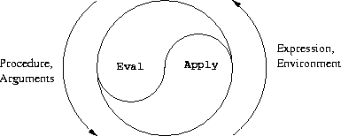
Computational Thinking & Systems Design Lecture 04: Low Level Software (Assembly Language)
Ben Koo
October 6, 2020

Slide 2
Objective
Demonstrate the instruction set of Hack Computer.
Also illustrate ideas in the Design of Instruction Sets.
Complex Instruction Set Computing (CISC) Architecture
Reduced Instruction Set Computing (RISC) Architecture
Mention the design of Graphical/Tensorial Processing Units
Mostly referred to as GPU and TPU

Slide 3
The Hack chip-set and hardware platform
Elementary logic gates
Nand
Not
And
Or
Xor
Mux
Dmux
Not16
And16
Or16
Mux16
Or8Way
Mux4Way16
Mux8Way16
DMux4Way
DMux8Way
Combinational chips
HalfAdder
FullAdder
Add16
Inc16
ALU
Sequential chips
DFF
Bit
Register
RAM8
RAM64
RAM512
RAM4K
RAM16K
PC
Computer Architecture
Memory
CPU
Computer
done
this lecture
done
done

Slide 4
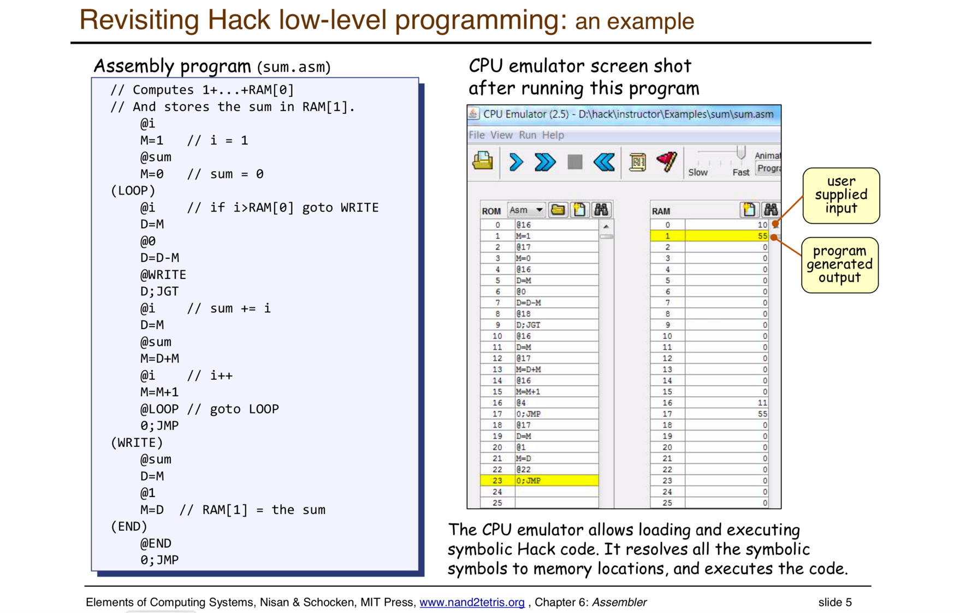

Slide 5
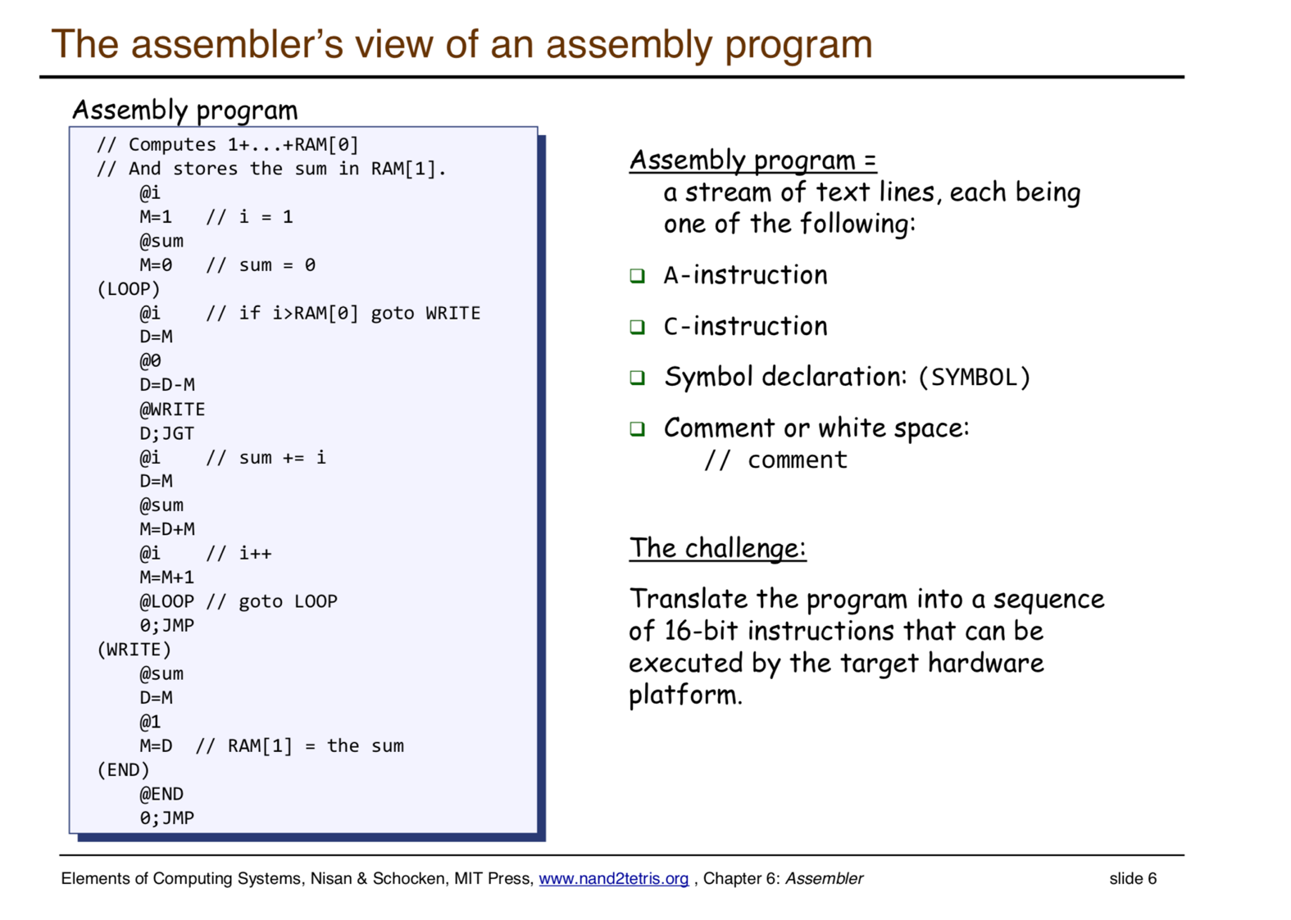

Slide 6
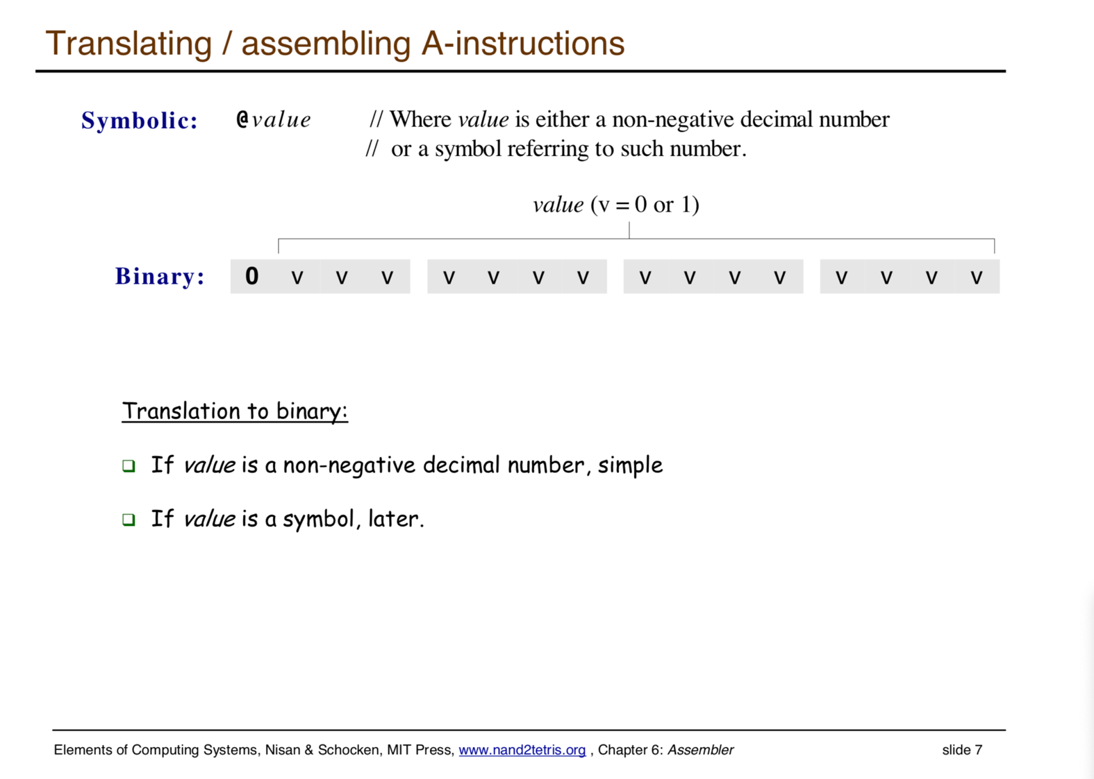

Slide 7
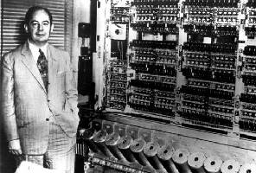
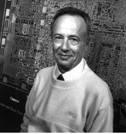
Von Neumann machine (circa 1940)
Stored program concept!
John Von Neumann (and others) ... made it possible
Andy Grove (and others) ... made it small and fast.

Slide 8
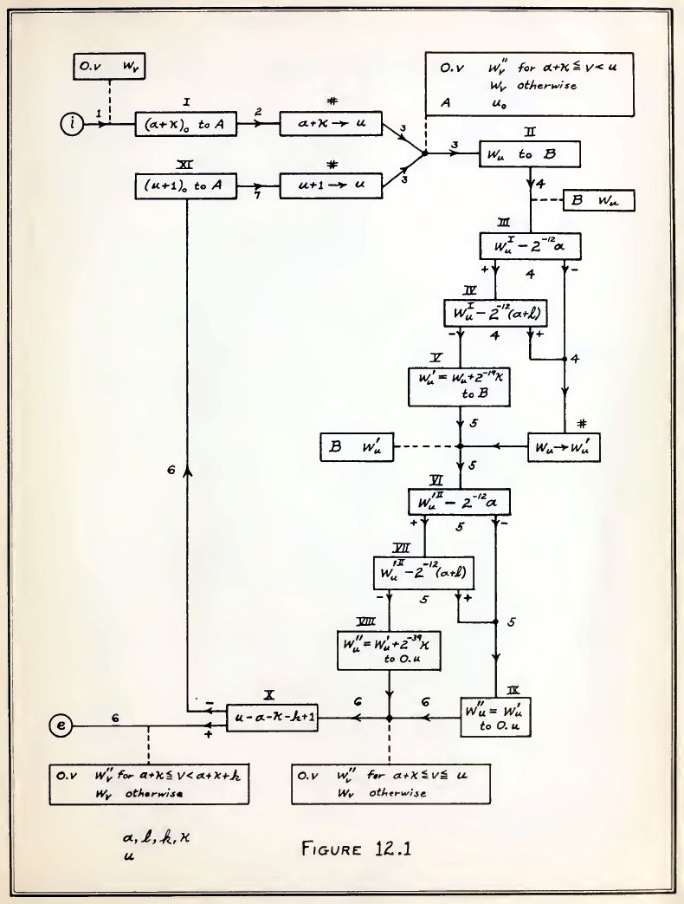

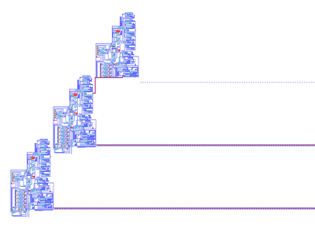
Who is Von Neumann？

Slide 9
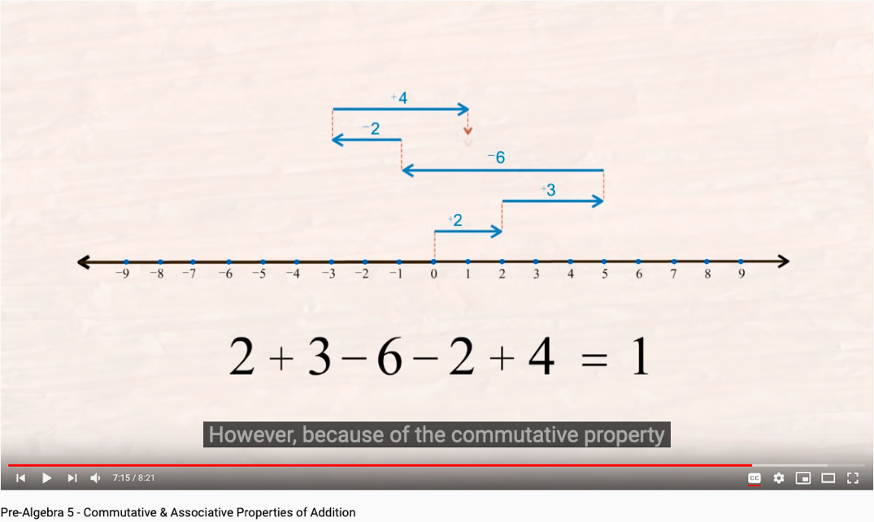
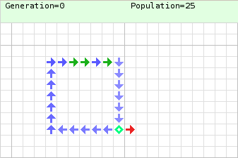
Von Neumann’s Idea: Computers as One Dimensional Automata

Slide 10
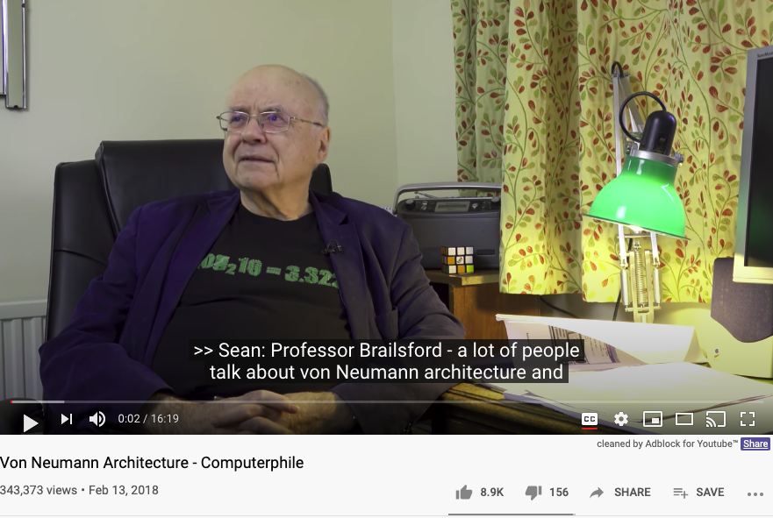
Von Neumann Architecture

Slide 11
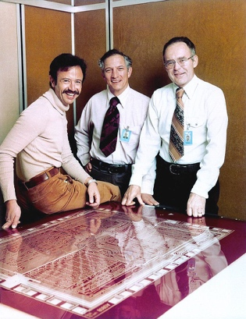
Who is Andy Grove？
The Father of OKRs (Logic Model equiv.)
One of the earliest investors in Google, John Doerr, called Andy Grove the "Father of OKRs" in Doerr's 2018 book, Measure What Matters: How Google, Bono, and the Gates Foundation Rock the World with OKRs. An acronym for Objectives and Key Results, it became central to Google's culture as a "management methodology that helps to ensure that the company focuses efforts on the same important issues throughout the organization.”The objective is the clearly defined goal, while the key results were the specific benchmarks to ensure achievement of that goal were "measurable and verifiable."
Grove stated that "you are making decisions about what the information technology world will want five years into the future ..."^{[16]}

Slide 12
Processing logic: fetch-execute cycle
Executing the current instruction involves one or more of the following micro-tasks:
Have the ALU compute some function out = f (register values)
Write the ALU output to selected registers
As a side-effect of this computation, figure out which instruction to fetch and execute next.

Slide 13
The Hack computer
A 16-bit Von Neumann platform
The instruction memory and the data memory are physically separate
Screen: 512 rows by 256 columns, black and white
Keyboard: standard
Designed to execute programs written in the Hack machine language
Can be easily built from the chip-set that we built so far in the course
Main parts of the Hack computer:
Instruction memory (ROM)
Memory (RAM):
Data memory
Screen (memory map)
Keyboard (memory map)
CPU
Computer (the logic that holds everything together).

Slide 14
Construction Plan
Instruction memory
Memory:
Data memory
Screen
Keyboard
CPU
Computer

Slide 15
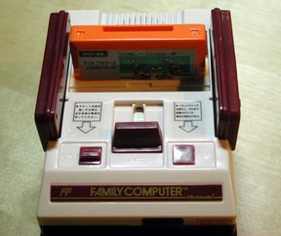
Instruction memory
Function:
The ROM is pre-loaded with a program written in the Hack machine language
The ROM chip always emits a 16-bit number: out = ROM32K[address]
This number is interpreted as the current instruction.

Slide 16
Think of ROM as a Bootstrapping Device
ROM is a Kind of “Firmware”
It almost never change (only bug fixes)
It needs to be compatible with hardware
It will be used at Boot time
Hack Computer needs it to store the Operating System
An Intel 2708 EPROM "chip" on a circuit board.

Slide 17
Data memory
load
Low-level (hardware) read/write logic:
To read RAM[k]: set address to k, probe out
To write RAM[k]=x: set address to k, set in to x, set load to 1, run the clock
High-level (OS) read/write logic:
To read RAM[k]: use the OS command out = peek(k)
To write RAM[k]=x: use the OS command poke(k,x)
peek and poke are OS commands whose implementation should effect the same behavior as the low-level commands
More about peek and poke this later in the course, when we’ll write the OS.

Slide 18
Construction Plan

Instruction memory
Memory:
Data memory
Screen
Keyboard
CPU
Computer


Slide 19
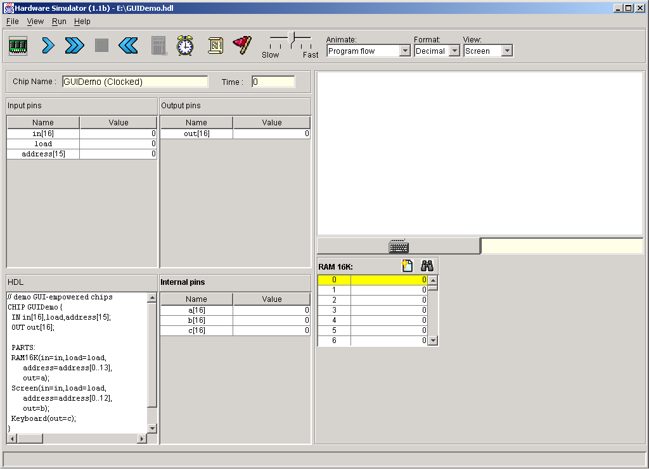
Screen
The bit contents of the Screen chip is called the “screen memory map”
Simulated screen:
The Screen chip has a basic RAM chip functionality:
read logic: out = Screen[address]
write logic: if load then Screen[address] = in
Side effect:
Continuously refreshes a 256 by 512 black-and-white screen device
The simulated 256 by 512 B&W screen
When loaded into the hardware simulator, the built-in Screen.hdl chip opens up a screen window; the simulator then refreshes this window from the screen memory map several times each second.

Slide 20
Screen memory map
In the Hack platform, the screen is implemented as an 8K 16-bit RAM chip.
How to set the (row,col) pixel of the screen to black or to white:
Low-level (machine language): Set the col%16 bit of the word found at Screen[row*32+col/16] to 1 or to 0 (col/16 is integer division)
High-level: Use the OS command drawPixel(row,col)
(effects the same operation, discussed later in the course, when we’ll write the OS).
Notes:
20

Slide 21
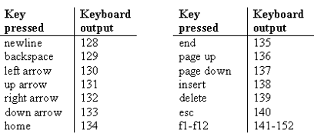

Keyboard
Simulated keyboard:
Keyboard chip: a single 16-bit register
Input: scan-code (16-bit value) of the currently pressed key, or 0 if no key is pressed
Output: same
The simulated keyboard enabler button
Special keys:
The keyboard is implemented as a built-in Keyboard.hdl chip. When this java chip is loaded into the simulator, it connects to the regular keyboard and pipes the scan-code of the currently pressed key to the keyboard memory map.
How to read the keyboard:
Low-level (hardware): probe the contents of the Keyboard chip
High-level: use the OS command keyPressed()
(effects the same operation, discussed later in the course, when we’ll write the OS).

Slide 22
Construction Plan

Instruction memory
Memory:
Data memory
Screen
Keyboard
CPU
Computer



Notes:
22

Slide 23
Memory: conceptual / programmer’s view
Memory
Data
Screen memory map
Video Memory = Screen Memory
Screen
Keyboard map
Keyboard
Using the memory:
To record or recall values (e.g. variables, objects, arrays), use the first 16K words of the memory
To write to the screen (or read the screen), use the next 8K words of the memory
To read which key is currently pressed, use the next word of the memory.
Notes:
23

Slide 24
Memory: physical implementation
load
The Memory chip is essentially a package that integrates the three chip-parts RAM16K, Screen, and Keyboard into a single, contiguous address space.
This packaging effects the programmer’s view of the memory, as well as the necessary I/O side-effects.
Memory
0
in
16
RAM16K
(16K mem. chip)
out
16383
16
address
16384
Screen
(8K mem. chip)
15
24575
Screen
24576
Keyboard
(one register)
Keyboard
Access logic:
Access to any address from 0 to 16,383 results in accessing the RAM16K chip-part
Access to any address from 16,384 to 24,575 results in accessing the Screen chip-part
Access to address 24,576 results in accessing the keyboard chip-part
Access to any other address is invalid.
Notes:
24

Slide 25
Lecture / construction plan

Instruction memory
Memory:
Data memory
Screen
Keyboard
CPU
Computer




Notes:
25

Slide 26
CPU
a Hack machine language instruction like M=D+M, stated as a 16-bit value
CPU internal components (invisible in this chip diagram): ALU and 3 registers: A, D, PC
CPU execute logic:
The CPU executes the instruction according to the Hack language specification:
The D and A values, if they appear in the instruction, are read from (or written to) the respective CPU-resident registers
The M value, if there is one in the instruction’s RHS, is read from inM
If the instruction’s LHS includes M, then the ALU output is placed in outM, the value of the CPU-resident A register is placed in addressM, and writeM is asserted.

Slide 27
CPU
a Hack machine language instruction like M=D+M, stated as a 16-bit value
CPU internal components (invisible in this chip diagram): ALU and 3 registers: A, D, PC
CPU fetch logic:
Recall that:
the instruction may include a jump directive (expressed as non-zero jump bits)
the ALU emits two control bits, indicating if the ALU output is zero or less than zero
If reset==0: the CPU uses this information (the jump bits and the ALU control bits) as follows:
If there should be a jump, the PC is set to the value of A; else, PC is set to PC+1
If reset==1: the PC is set to 0. (restarting the computer)
Notes:
27

Slide 28
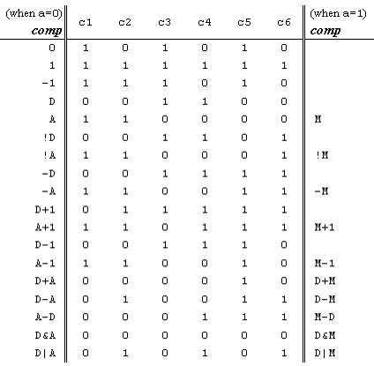
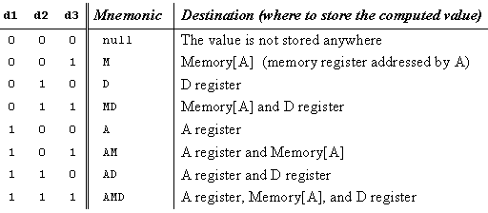
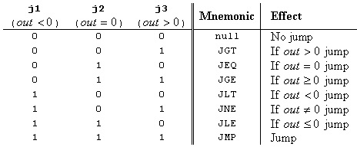
The C-instruction revisited

Slide 29
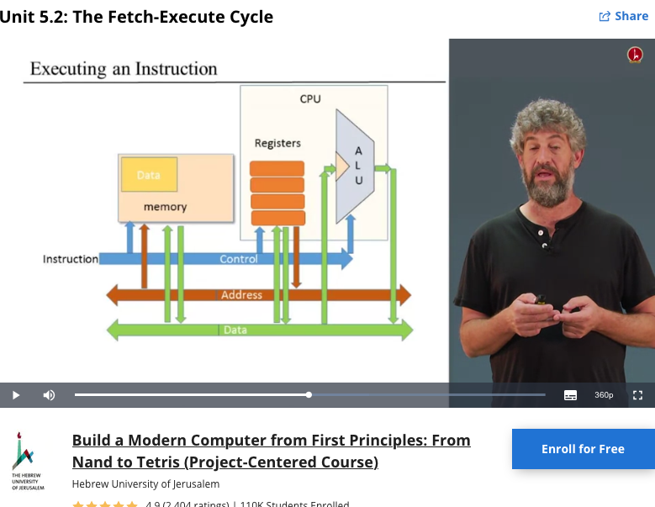
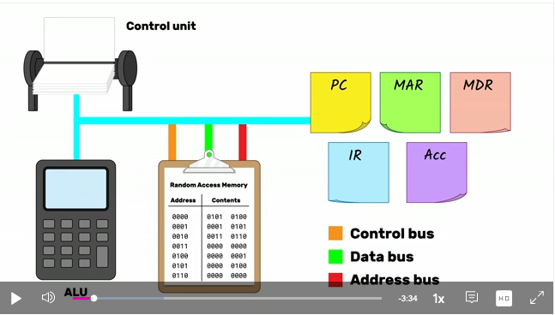
Fetch-Execute Cycle： Code that move itself

Slide 30
Chip diagram:
Includes most of the CPU’s execution logic
The CPU’s control logic is hinted: each circled “c” represents one or more control bits, taken from the instruction
The “decode” bar does not represent a chip, but rather indicates that the instruction bits are decoded somehow.
Cycle:
Execute
Fetch
Execute logic:
Decode
Execute
Fetch logic:
If there should be a jump, set PC to A else set PC to PC+1
Resetting the computer:
Set reset to 1, then set it to 0.

Slide 31
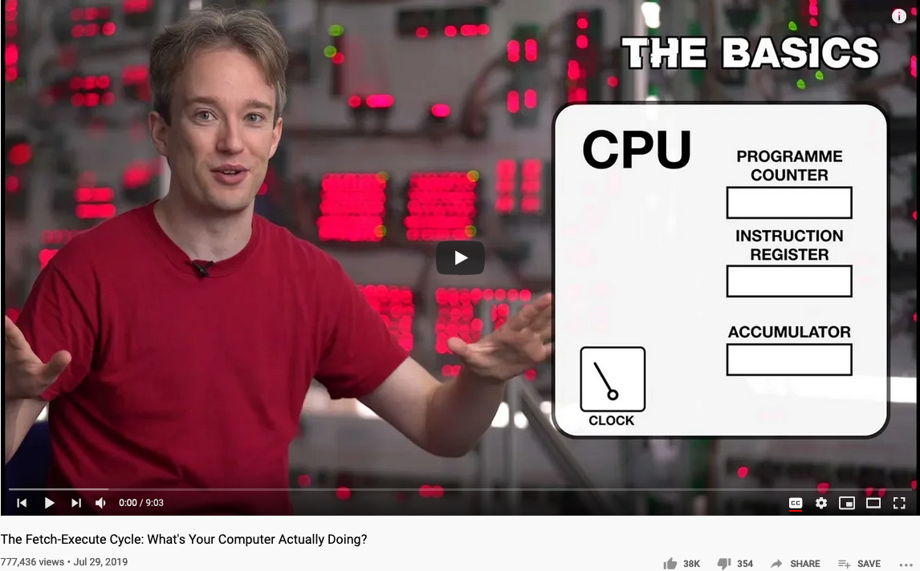
See Fetch-Execute Cycle in Action

Slide 32
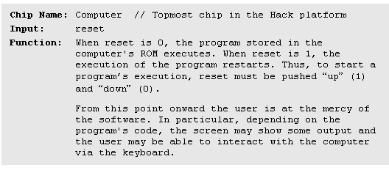
Computer-on-a-chip interface

Slide 33
Computer-on-a-chip implementation
CHIP Computer {
IN reset;
PARTS:
// implementation missing
}
Implementation: Simple, the chip-parts do all the hard work.

Slide 34
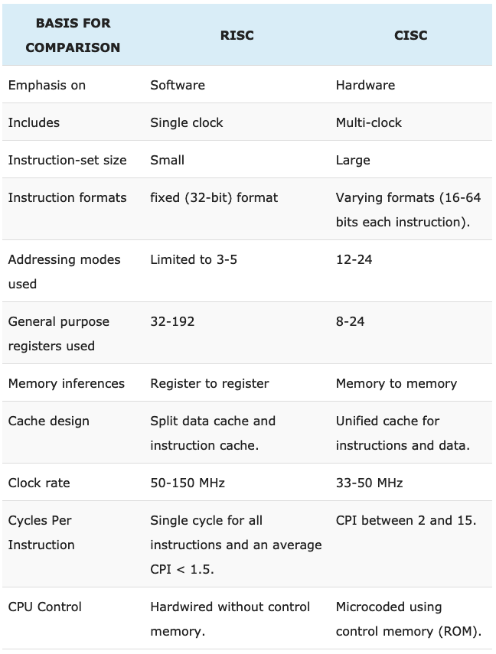
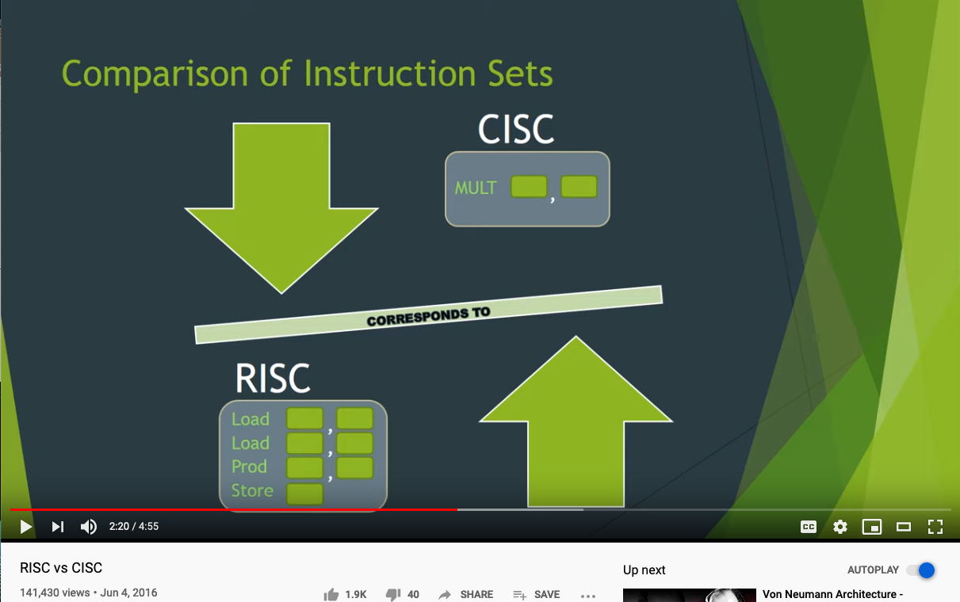
RISC and CISC
RISC: Reduced Instruction Set Computing
CISC: Complex Instruction Set Computing
Comparing RISC vs. CISC
https://techdifferences.com/difference-between-risc-and-cisc.html

Slide 35
Perspective: from here to a “real” computer
Caching
More I/O units
Special-purpose processors (I/O, graphics, communications, …)
Multi-core / parallelism
Efficiency
Energy consumption considerations
CPU as a factory that moves code and produces code
Transports and Modifies Code

Slide 36
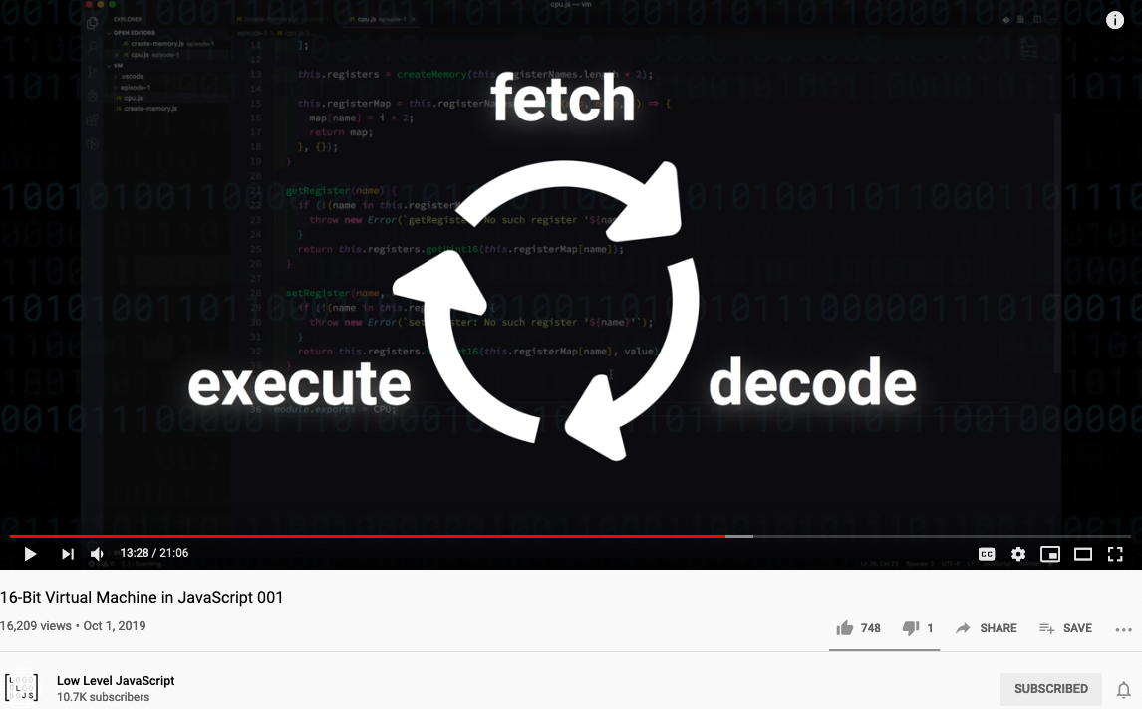
Emulate this cycle by JavaScript

Slide 37
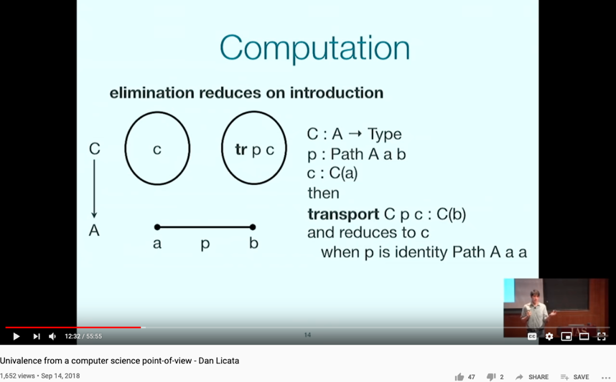
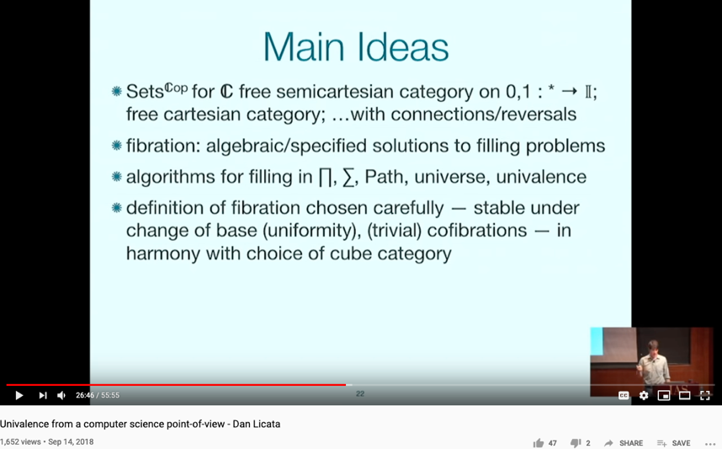
Computing from a Univalence Perspective

Slide 38
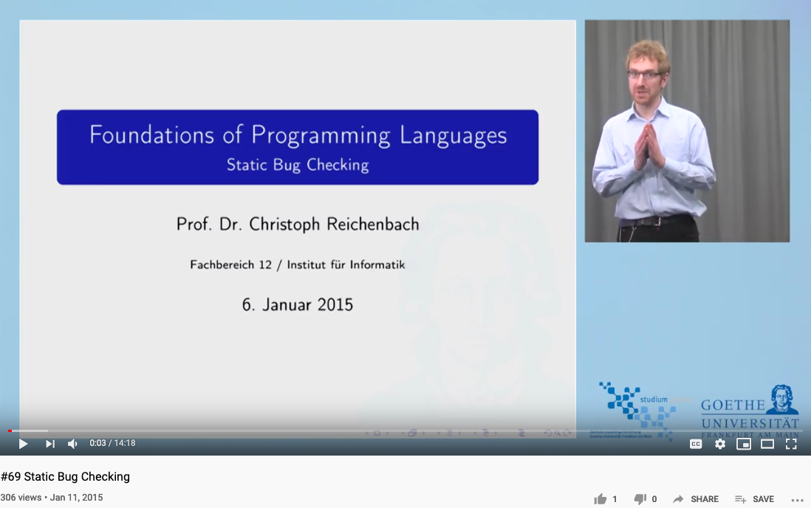
STATIC ANALYSIS
https://youtu.be/ZsuKm-iFXuo

Slide 39
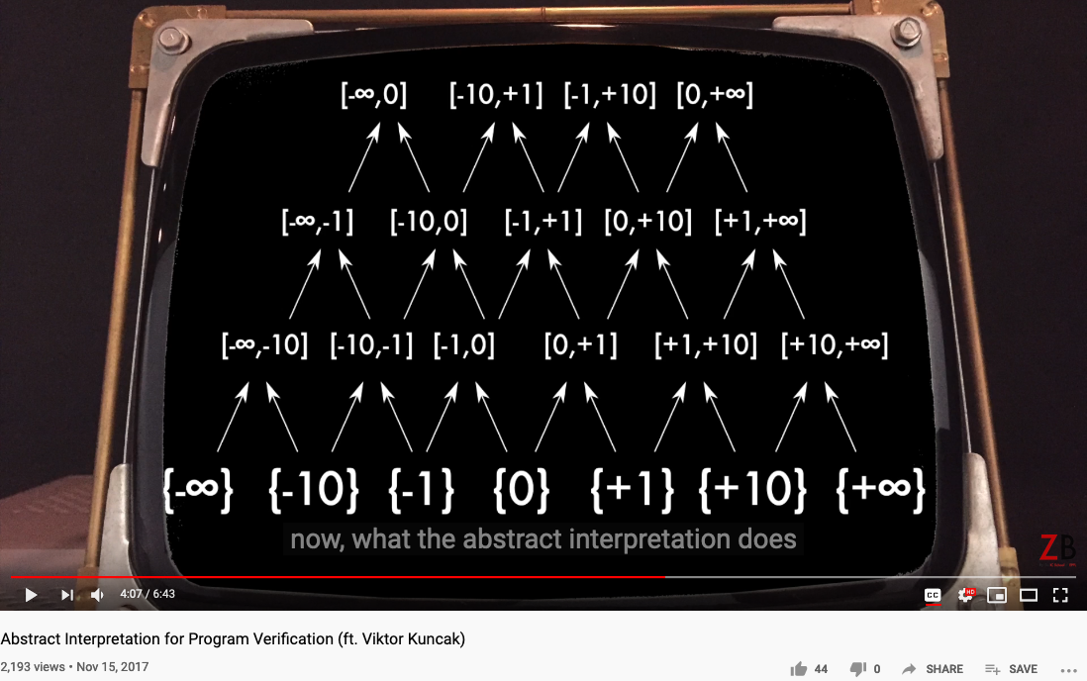
ABSTRACT INTERPRETATION
https://youtu.be/j2m5YMnHvQQ

Slide 40
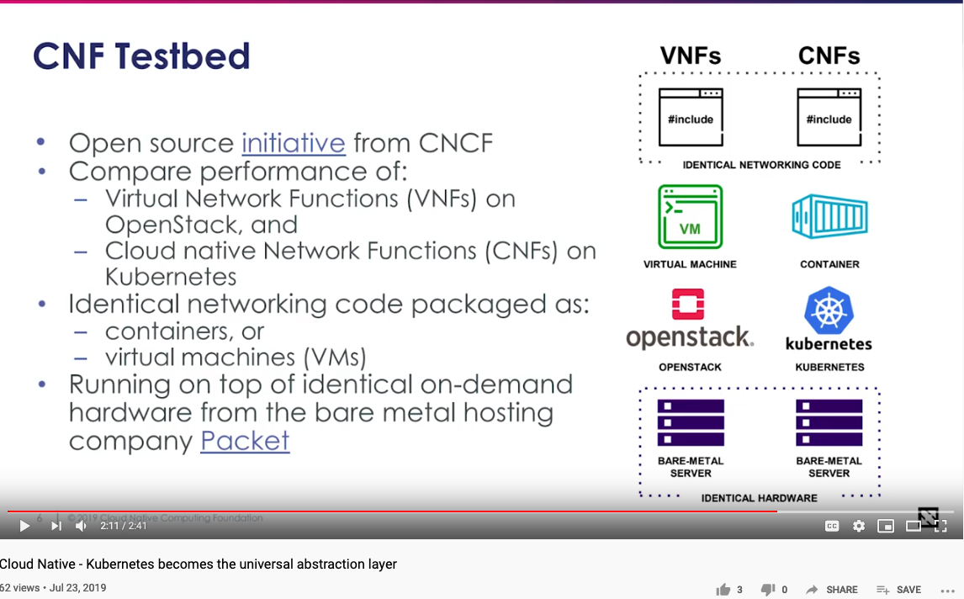
A Universal Abstraction

Slide 41
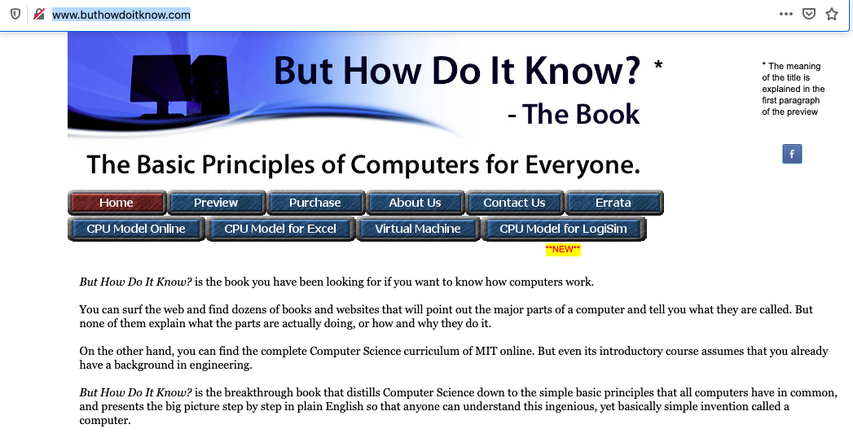
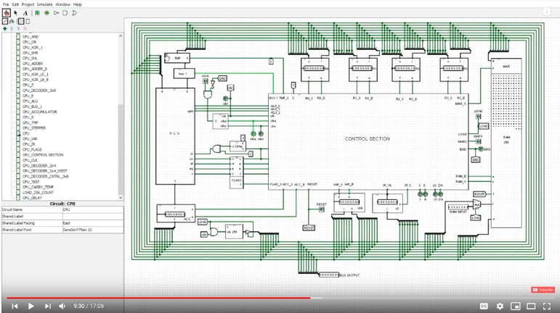
How do it know?

Slide 42
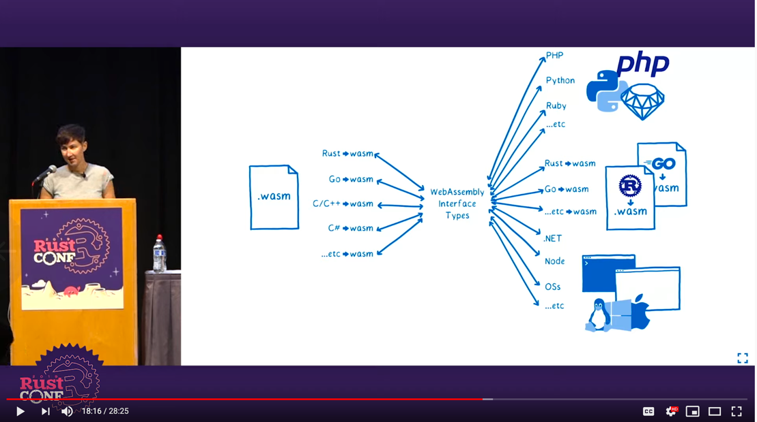
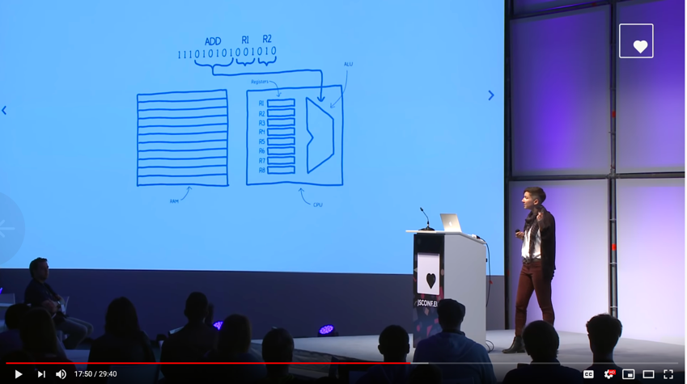
WebAssembly
Please also try:
https://webassembly.studio/
RustConf 2019 - Closing Keynote by Lin Clark
Lin Clark: A Cartoon Intro to WebAssembly | JSConf EU

Slide 43
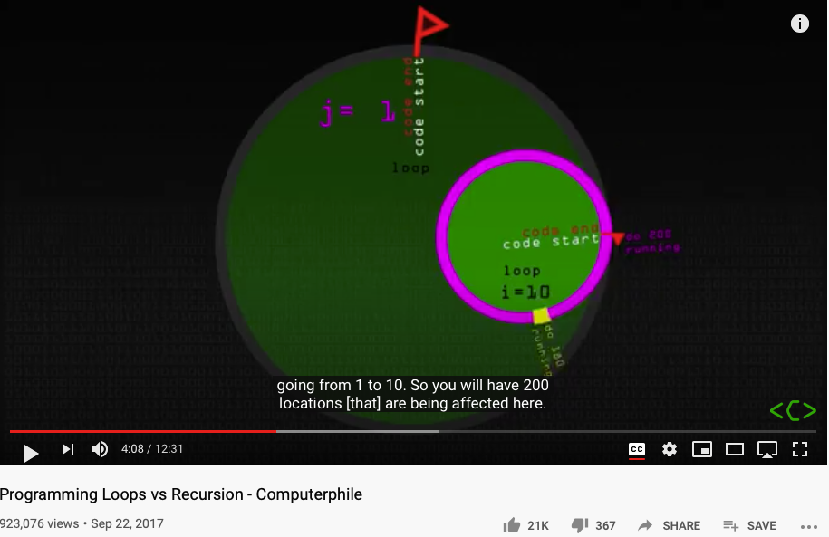
Loop and Recursion

Slide 44
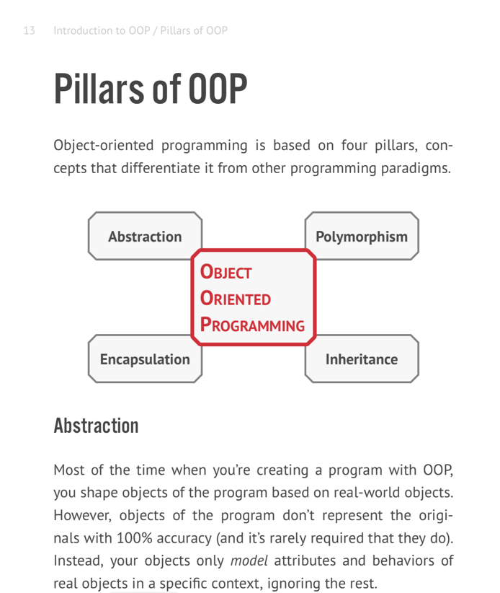

面向对象的编程

Slide 45
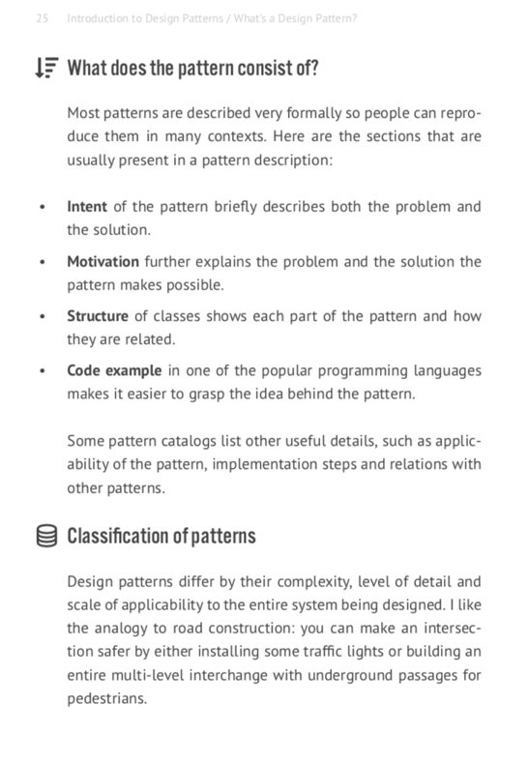
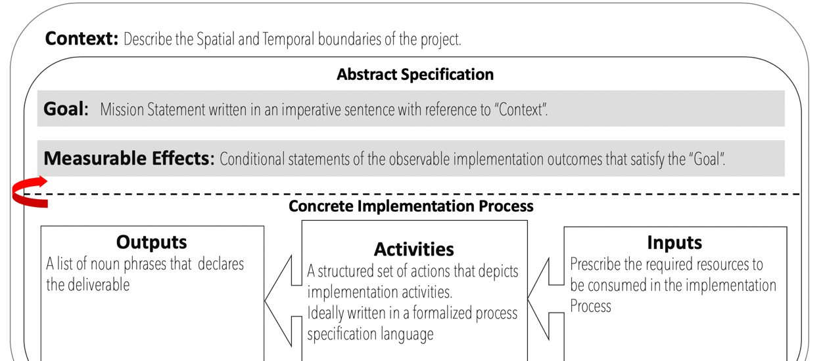
设计模式与逻辑模型

Slide 46
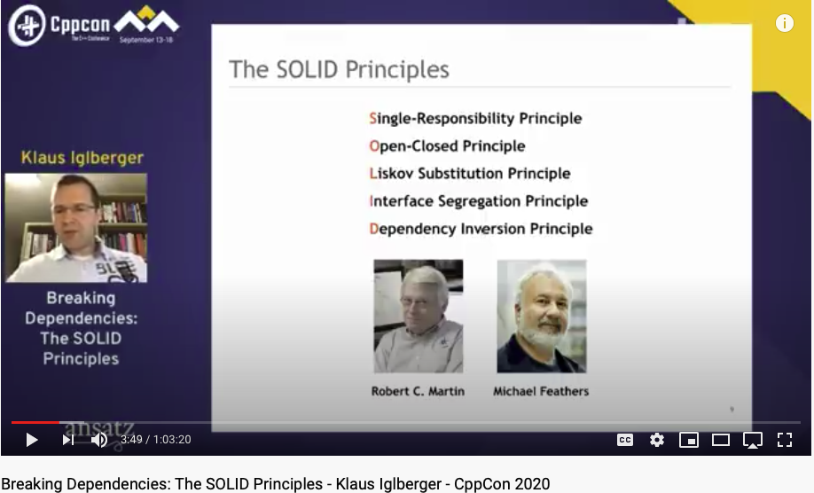
Software Dependencies?

Slide 47
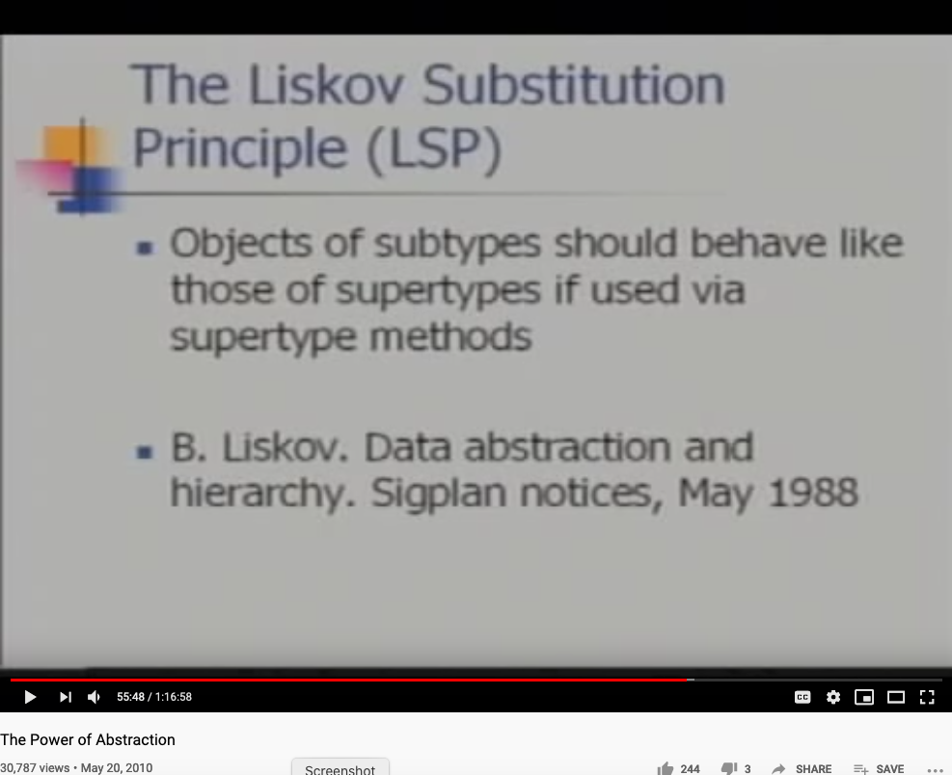
The Power of Abstraction by Prof. Liskov

Slide 48
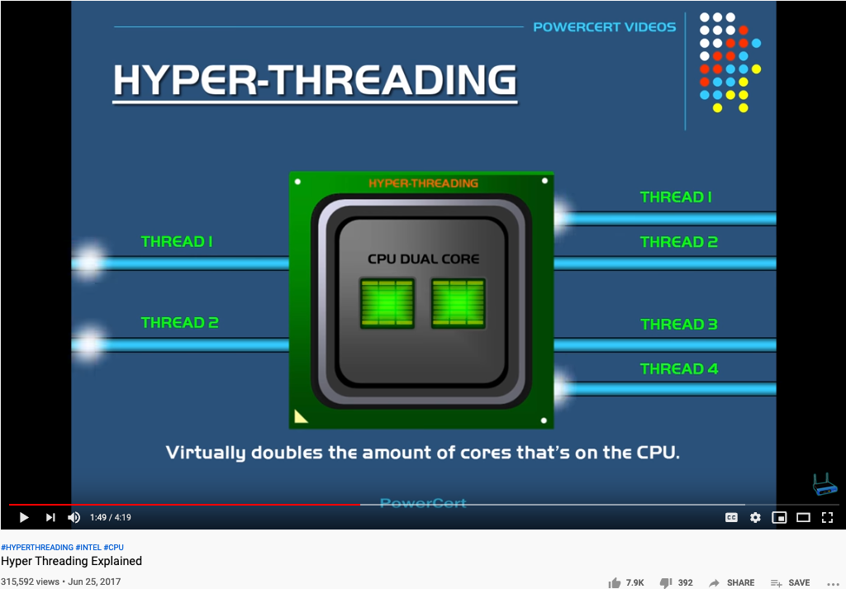
What is Hyper-threading?

Slide 49
第四周回顾: 汇编语言与WebAssembly
内容:
汇编语言的符号是助记码，对应的是特定的硬件指令和地址。
Hack计算机的架构是Harvard Architecture, 所以程序是存在ROM，而数据存在RAM
Fill 程序体现了Hack架构的输入（键盘）与输出（屏幕）的两类设备（Device）
在Hack架构下的所有运算结果，都是通过对RAM的内容改动来完成变化，包括控制输入与输出的设备（Device）状态。
WebAssembly是一种介于虚拟机和汇编语言的抽象机器语言，其存在价值是为了包装低阶的指令集，从而可以通过一个标准化的低阶语言标准，优化各种高阶语言的编译流程。

Slide 50
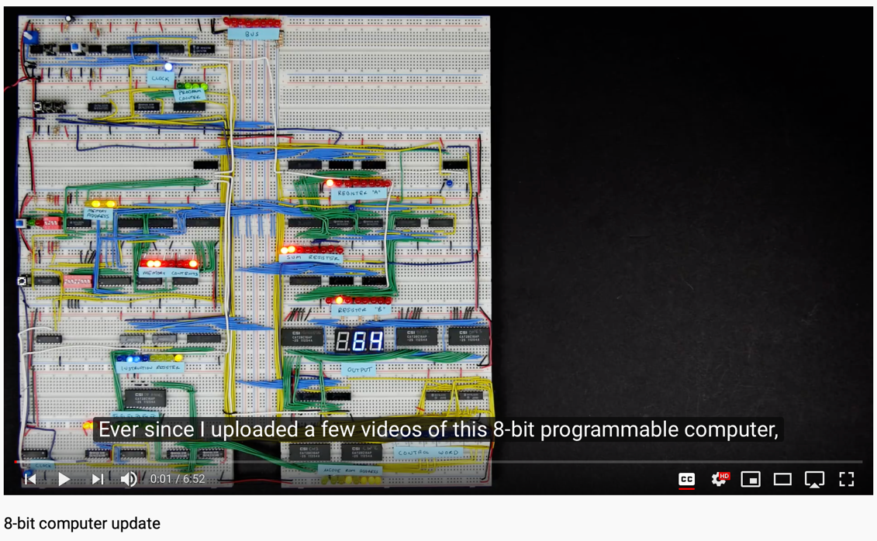
参考文献:
视频:
Coursera Video website: https://www.coursera.org/learn/build-a-computer
Building an 8-bit Computer :https://eater.net.

Slide 51
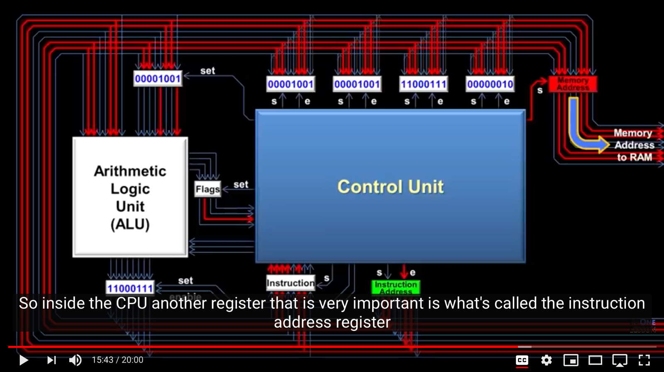
See How a CPU Work
Notes:
51

Slide 52
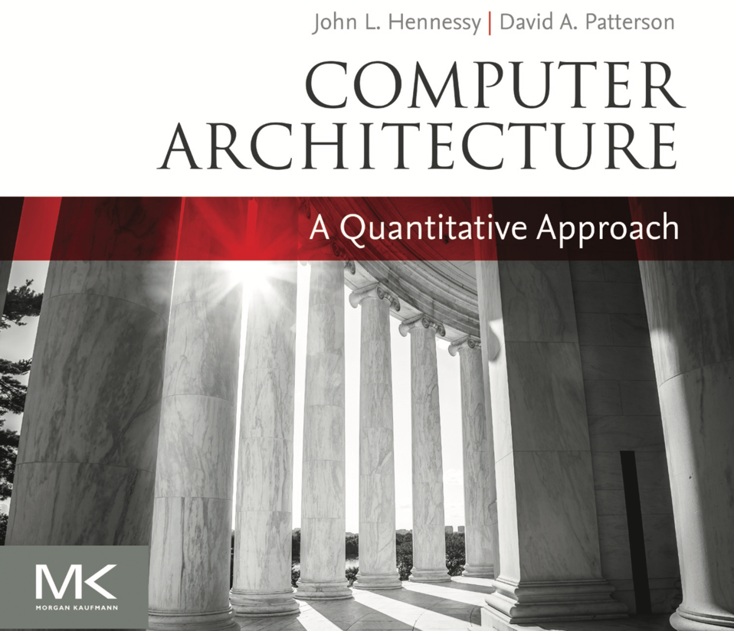
Computer Architecture: A Quantitative Approach
www.nand2tetris.org
Notes:
52

Slide 53
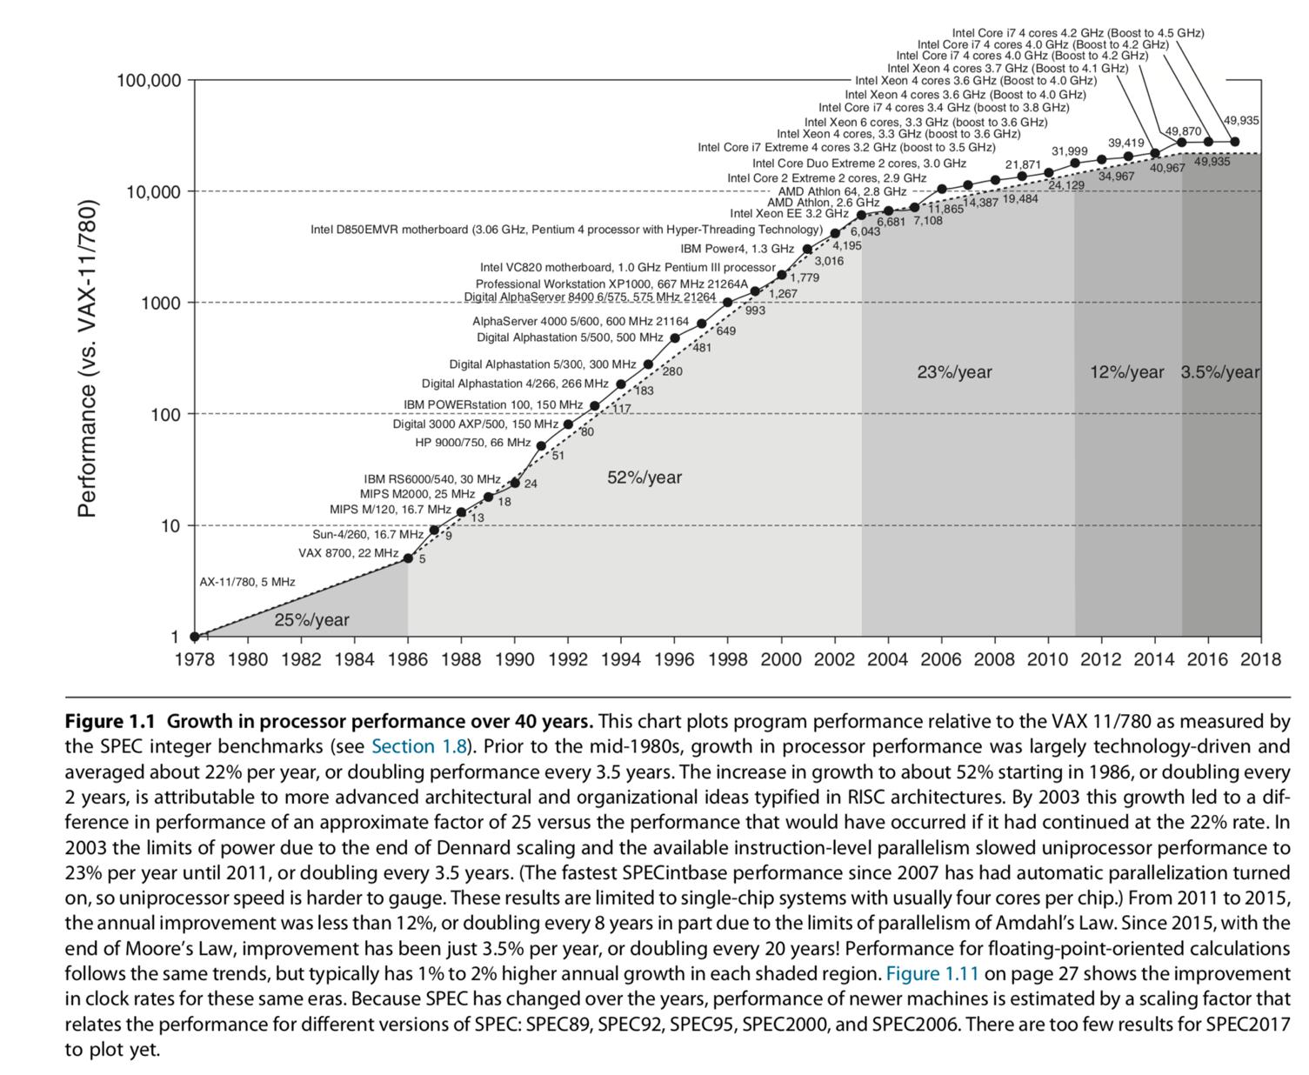

Slide 54

History of CPU Development

Slide 55
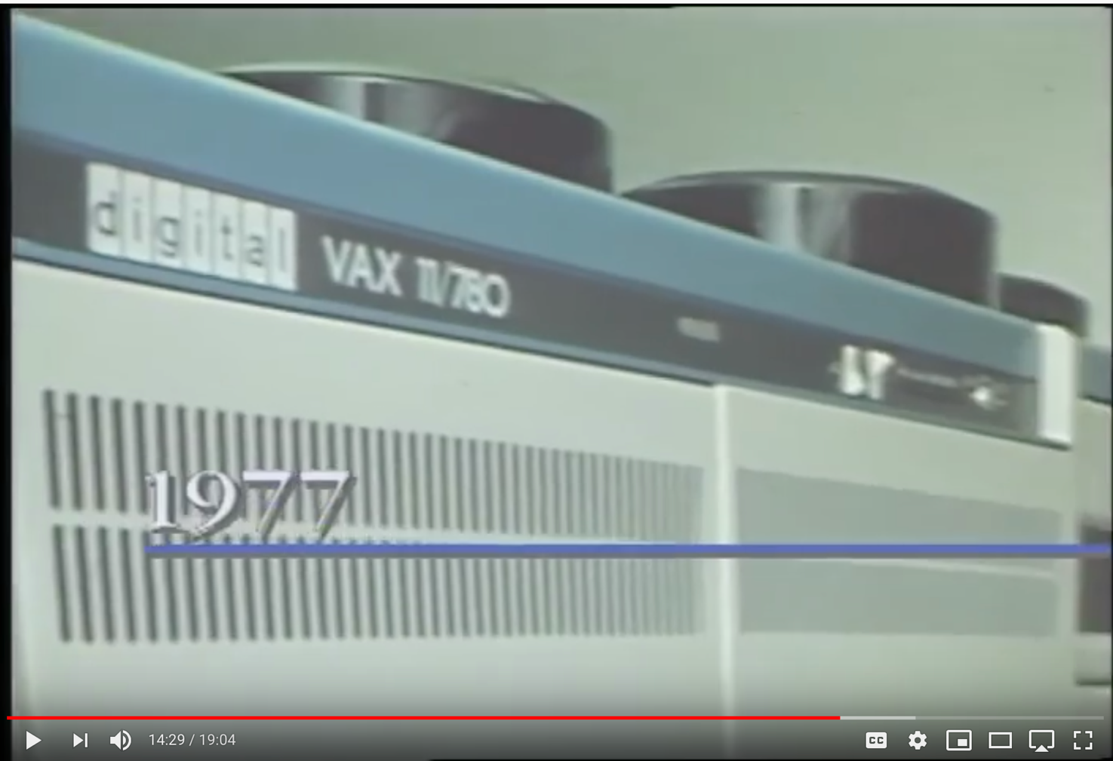
The Vax 11/780 Computer

Slide 56
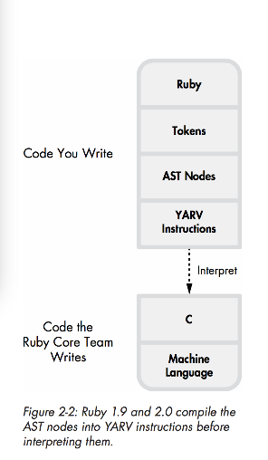
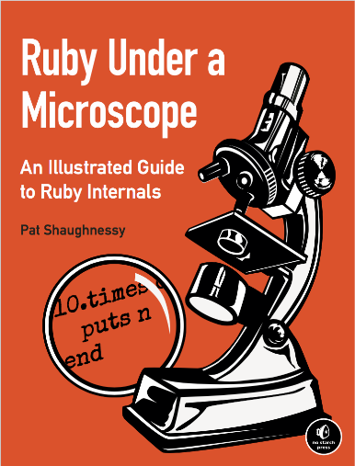
Low level instruction as Stacks
YARV： Yet Another Ruby Virtual Machine

Slide 57
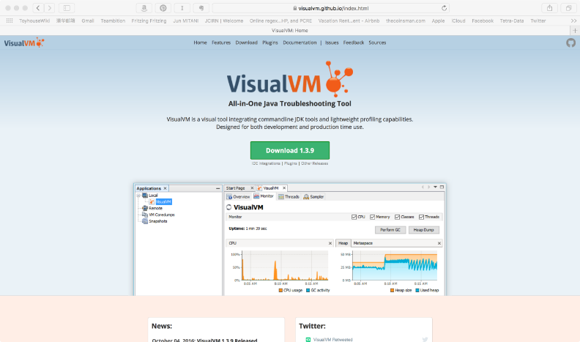
Java虚拟机运行状态的可视化工具
https://visualvm.github.io/index.html

Slide 58
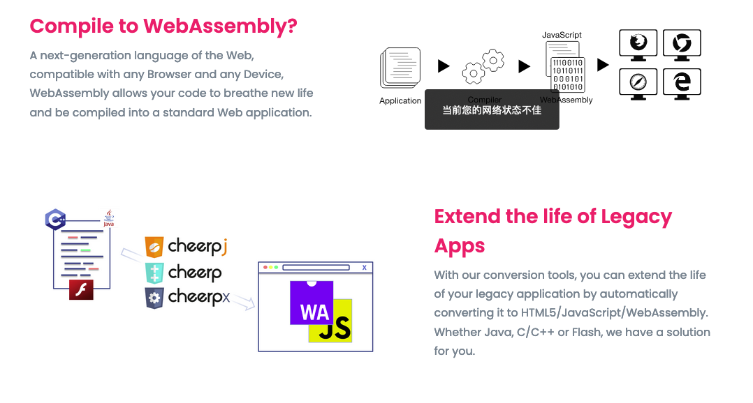
Web Assembly for Java
https://leaningtech.com/index.html

Slide 59


Some Tutorial
https://github.com/leaningtech/cheerp-meta/wiki/Cheerp-Tutorial%3A-Mixed-mode-C++-to-WebAssembly-and-JavaScript

Slide 60

WebAssembly Explorer
https://mbebenita.github.io/WasmExplorer/

Slide 61
WebAssembly Explorer
https://mbebenita.github.io/WasmExplorer/

Slide 62

Formulas for Comp. Arch. I

Slide 63

Formulas for Comp. Arch. II

Slide 64

Formulas for Comp. Arch. III

Slide 65

Formulas for Comp. Arch. IV

Slide 66

How Internet Works by Ben Eater

Slide 67

The Grand Daddy of WWW
Nelsdon thinks Nakamoto is: Shinichi Mochizuki
Ted Nelson in 2013:
https://youtu.be/emDJTGTrEm0?t=474

Slide 68

The Grand Daddy of Wiki
Ted Nelson’s Hypertext

Slide 69

A Workflow with Copyright Protection

Slide 70
Procedure

